Slide 1
Health Ministries Association, Inc.
hmassoc.org

Slide 2
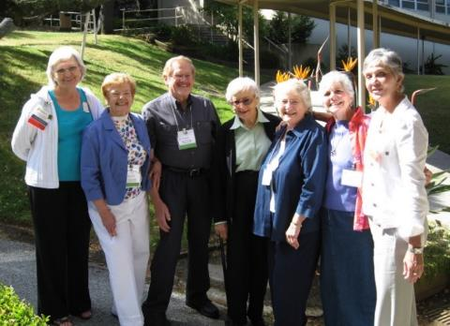
Health Ministries Association, Inc. – Who We Are
Founded in 1989 under the guidance of Rev. Dr. Granger Westberg and others. Founding officers included:
Joann Gragnani Boss, Jean Denton, David F. Carlson, James Scherf, Anne Marie Djupe, and Joni Goodnight
The membership organization for people of faith in various roles impacting the health of their community
The professional membership association recognized by the American Nurses Association to represent Faith Community Nursing

Slide 3
Health Ministries Association, Inc.
Our Vision
HMA aspires to engage, educate and empower people of faith to be passionate and effective leaders for creating healthier communities
Our Mission
HMA encourages, supports and empowers leaders in the integration of faith and health in their local communities

Slide 4
Health Ministries Association, Inc.
An association for people of faith working together:
Faith Community nurses
Health Ministers
Program Coordinators
Spiritual Leaders (Clergy/Chaplains)
Membership:
FCN 63%
Health Minister – 8%
Program Leader – 16%
Spiritual Leader – 3%
Other – 15%

Slide 5
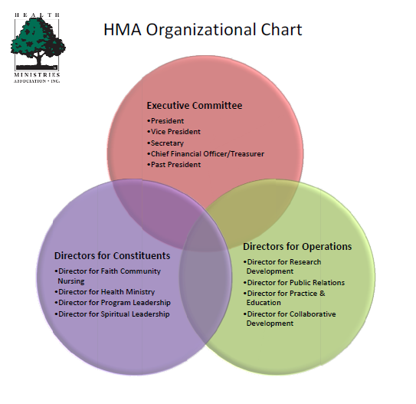

Slide 6
Collaborators & Working Relationships
American Nurses Association (ANA)
American Nurses Credentialing Center (ANCC)
American Red Cross
Carolinas Health Ministry Partnership
Catholic Health Association - Community Benefit & Continuing Care
Center for Disease Control and Prevention Office on Smoking and Health
Faith United to End Childhood Obesity (FUTECO)
Faith United to End Gun Violence
(Sponsored by the Brady Campaign)
Health Human Services - Office of Women’s Health
Let’s Move Faith and Communities
National Association of Catholic Nurses USA
National Council on Aging (NCOA)
Nurses Christian Fellowship /Journal of Christian Nursing (JCN)
Texas Health Ministries Network
United Church of Christ National FCN Leadership Team
Westberg Institute for Faith Community Nursing (Church Health Center)
Other Local/Regional Networks
Notes:
ANA - Invited to attend Inaugural ANA Membership Assembly
ANCC - The ongoing work with the American Nurses Credentialing Center in 2013 has resulted in the following:
Signed Contract and provided funding for credentialing process for Faith Community Nurses
Survey review for certification process
Let’s Move Campaign
Faith Communities continue to sign up in support of the initiative

Slide 7
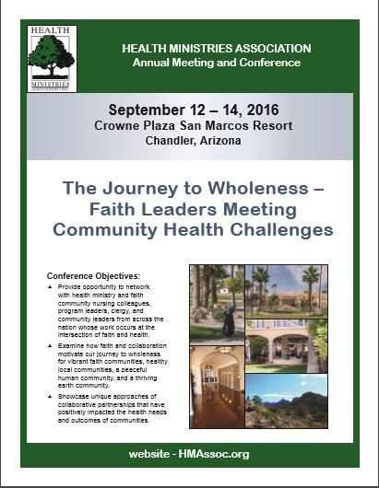
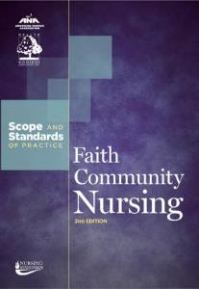
Benefits of Membership
FCN Mentoring Program
Participation on Committees
Nationwide Networking
Financial Discounts
Registration for Annual Conference
FCN Certification
Publications & Resources
Scope & Standards of Practice for Faith Community Nursing
The Health Minister Role: Guidelines and Foundational Curriculum Elements
Journal of Christian Nursing

Slide 8
Faith Community Nurse (FCN)
Faith community nursing is the specialized practice of professional nursing that focuses on the intentional care of the spirit as part of the process of promotion of holistic health and prevention or minimization of illness within the context of a faith community.
Source: American Nurses Association and Health Ministries Association (2012). Faith Community Nursing Scope and Standards of Practice, 2nd Edition

Slide 9
Specialty of Faith Community Nursing
HMA has a longstanding collaborative relationship with the ANA for both the establishment and recognition of this specialty practice.
Scope & Standards of Practice for Parish Nursing - 1998 (Acknowledged by the American Nurses Association, Congress of Nursing Practice & Economics, February 1998)
Scope & Standards of Practice for Faith Community Nursing - 2005 (HMA sponsored work group)
Scope & Standards of Practice for Faith Community Nursing , 2nd edition, January 2012 (HMA sponsored work group)
Scope & Standards of Practice for Faith Community Nursing in revision by HMA sponsored work group; anticipated publication fall 2016.

Slide 10
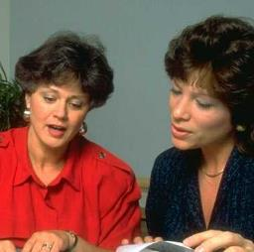
HMA FCN Mentor Program
The novice FCN needs guidance and support after completion of a Foundational FCN curriculum in order to establish and sustain a successful professional practice.
HMA recognizes that many FCN begin their role as a lone practitioner without the benefit of a health system or network to provide a nurturing environment for spiritual and professional growth and development.
The HMA FCN Mentor Program links the novice HMA FCN member with an experienced HMA FCN leader to facilitate sharing of knowledge, experiences, and wisdom.
The program encourages growth and achievement by providing an open and supportive environment in the development of professional practice.

Slide 11
Faith Community Nursing Certification
HMA has been the driving force working toward formal certification for faith community nursing.
In 2013, HMA provided the funding to the American Nurses Credentialing Center (ANCC) for their development of certification through portfolio for faith community nursing.
Sept. 15, 2014 ANCC and HMA announced certification for faith community nurses.
Information available at ANCC website: www.nursecredentialing.org

Slide 12
Faith Community Nursing Society
In an effort to identify and recognize HMA faith community nurses who have achieved certification through ANCC in Health Ministries Associations Inc., has developed the Faith Community Nursing Society.
Statement of Purpose
To recognize superior achievement in the specialty practice of faith community nursing for faith community nurse members of HMA
To strengthen commitment to the ideals and purposes of the profession and the organization that supports the work of faith community nursing
To encourage ongoing leadership and involvement (present and future) in the evolving practice of faith community nursing through efforts led by HMA
To share best practices, attend educational seminars, discuss research, promote professional publication, and engage in peer-to-peer networking.
To support and assist with improvement of the related specialty through identification and development of new skills.

Slide 13
Faith Community Nursing Society
Membership Criteria
Criteria for consideration:
Faith Community Nurse Member in good standing ~Health Ministries Association, Inc.
Faith Community Nursing Certification achieved in Faith Community Nursing through ANCC
Ongoing demonstration of the Vision & Mission of Health Ministries Association, Inc.
Active Members of the Faith Community Nursing Society will be listed on the main HMA page newly created Faith Community Nursing Society roster.

Slide 14
Are YOU the missing piece?
Your membership is important in the ongoing development of the integration of faith and health!
You are VITAL to advancing this nursing specialty!

Slide 15
JOIN HMA
Be Active
Lead
Contribute
Membership Levels:
Standard dues – $105.00/year (rolling calendar)
Student/Senior/Group Discounts – Contact the HMA office

Slide 16
Contact Information
P.O. Box 60042, Dayton, OH 45406
hmassoc.org • info@hmassoc.org
1–800–723–4291 Office Manager

